Slide 1
Seminar 5
UML Object Diagram

Slide 2
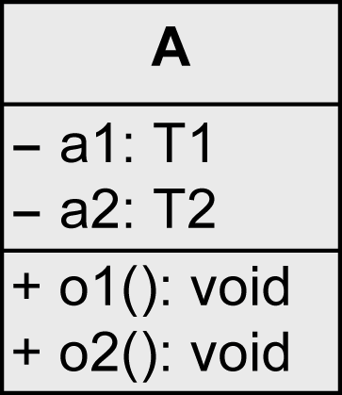
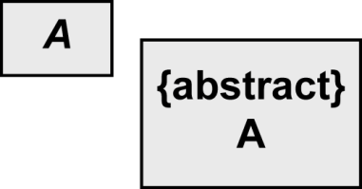
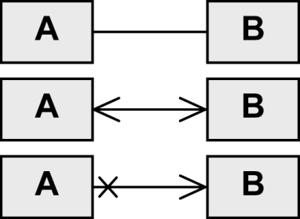
Notation Elements (1/3)
Name | Notation | Description
Class |  | Description of the structure and behavior of a set of objects
Abstract class |  | Class that cannot be instantiated
Association |  | Relationship between classes: navigability unspecified, navigable in both directions, not navigable in one direction
oder

Slide 3
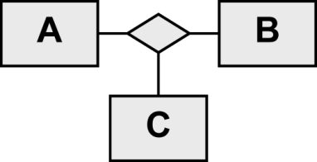
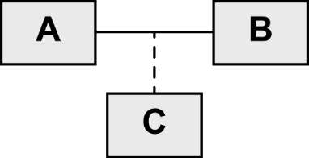
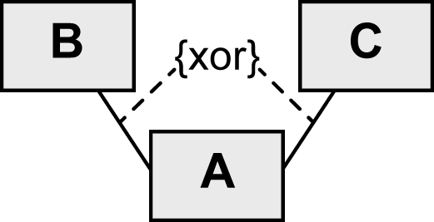
Notation Elements (2/3)
Name | Notation | Description
n-ary association |  | Relationship between n (here 3) classes
Association class |  | More detailed description of an association
xor relationship |  | An object of C is in a relationship with an object of A or with an object of B but not with both

Slide 4
Notation Elements (3/3)
Name | Notation | Description
Shared aggregation |  | Parts-whole relationship (A is part of B)
Strong aggregation = composition |  | Existence-dependent parts-whole relationship (A is part of B)
Generalization |  | Inheritance relationship (A inherits from B)
Object |  | Instance of a class
Link |  | Relationship between objects

Slide 5
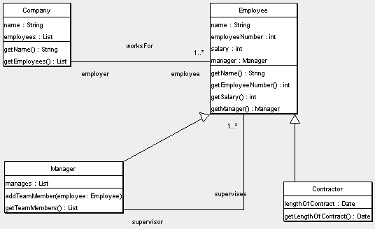
Class diagram – ex1
Give an interpretation of the class diagram below!

Slide 6
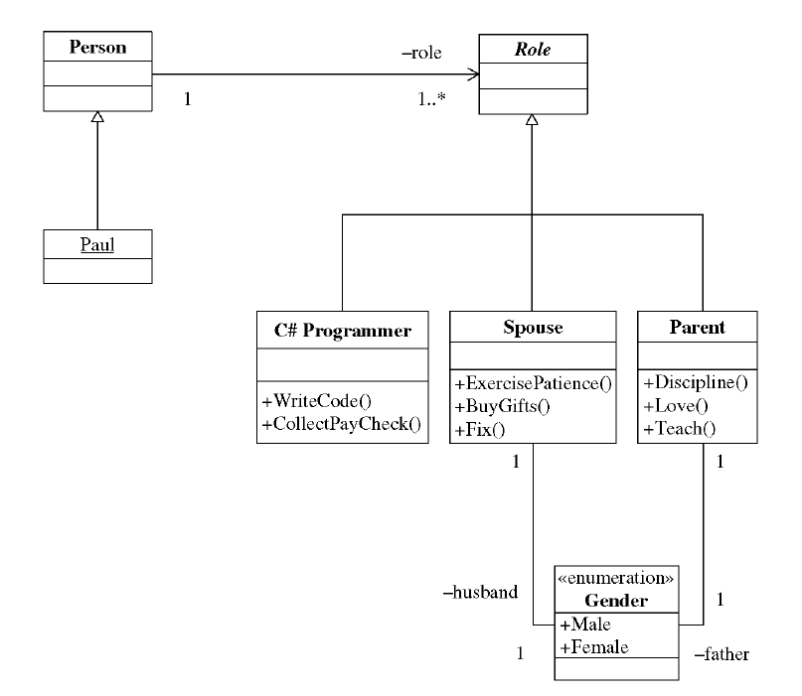
Class diagram – ex2
Give an interpretation of the class diagram below!

Slide 7
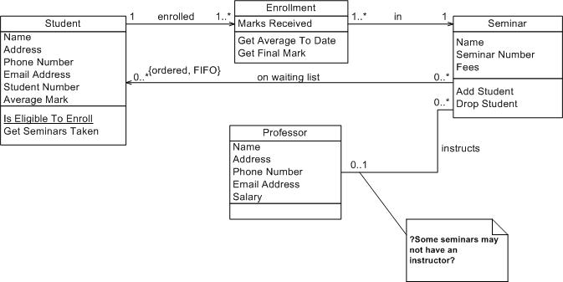
Class diagram – ex3
Give an interpretation of the class diagram below!

Slide 8
Draw class diagrams for the situations below
A team consists of 11 players, of which one is the captain..
A company consists of departments. Departments are located in one or more office buildings. One office functions as headquarters. Each department has a manager who is recruited from among its employees.
Model the relationship between a student and a professor, knowing that a student can take exams in courses taught by that professor or the latter may be the student's advisor for master's thesis.
A customer can get a loan from a bank only if it offers a real estate guarantee in this regard.
Notes:
Modelaţi relaţia dintre diferite tipuri de vehicule motorizare sau nu.

Slide 9
Object diagram
It consists of objects and the links between them.
It serves to validate the class diagram.
A link is a relationship between two objects.
An object is named using its name, the sign ":" followed by the name of the class to which he belongs: Object Name: Class name.
There may be anonymous objects, known only by class name..
Object diagram | Class diagram
Models facts about certain entities | Models rules for types of entities.
Represents real objects | Represent abstractions of concepts.
Connects objects | Associates entities

Slide 10
Class and Object diagram notation – a comparison
Class diagram | Object diagram
The class has three compartments: name, attributes and operations. | An object has only two compartments: names and attributes.
The class name is specified alone in the first compartment. | The format of an object’s name includes class names. These notations are found in other diagrams that represent objects
The second section describes the properties as attributes. | The second section defines values for each attribute, in order to test the model.
Operations show up in the description of the class. | Operations are not included in objects because they are identical for each object of the class.
Classes are connected by associations that have a name, multiplicity, constraints and roles. Classes are an abstraction of objects, so it is necessary to specify how many classes are participating in an association. | The objects are connected by a relationship that can have a name, roles, but not multiplicities. Objects are singular entities, all links are one-on-one, and multiplicities are irrelevant.

Slide 11
Object diagram in Visual Paradigm
Define the class diagram, in which the classes have attributes
Define an object in the Object diagram (Instance Specification).
Select the class to which the object belongs: Right click on the object -> Select Classifier-> tick and select the appropriate class
Optionally, the object is given a name.
Define values for attributes: Right click on the object -> Slots, Slots Define (for attributes we want to give values to) -> Edit Values-> Add -> Text (insert desired value).
We create links (Link) between objects.

Slide 12
Object diagram in Visual Paradigm- example

Slide 13
Seminar scenario
Create the class diagram for the scenario below
The project goal is to develope a software application for the management of a hotel business unit. In order to check in, a customer can request to reserve one or more rooms by e-mail or telephone. For this, he provides the receptionist with information on the period of accommodation and type of rooms required. Customers will get discounts if they reserve at least 3 rooms or if the period of accommodation exceeds 5 days. The receptionist checks availability and notifies the client of this and the estimated cost of accommodation. If there are no rooms available as requested, the receptionist can provide alternatives to the customer. The client may request a discount (additional or not) and the receptionist will decide the feasibility discount, assisted mandatory by the hotel manager. If the client agrees with the proposed price, they proceed to the reservation. For new customers, the receptionist asks identification data, which he introduces in the application.
Once at the hotel and if it has made a prior booking, the customer will provide his identification and / or booking number and the check in is finalized. If there is no reservation, the availability for the required period will be checked. When there is such a room, accommodation is made. At the end of the stay, the receptionist prepares a list of all the services used by the customer and their price. The list must be validated by the customer, then the final invoice is drawn up. The invoice can be paid partially or fully by bank transfer, cash or using a credit card. Also, before leaving the hotel, the customer is asked to complete a form to evaluate the services provided by the hotel premises

Slide 14
Class diagram –steps
Identify classes – analyze the scenario description and find the nouns; decide which of them should become classes
Identify class attributes – which of the identified nouns are, in fact, attributes of classes? What other attributes can you add? (few)
Identify relationships between classes:
Association
Generalization (is a type of)
Aggregation (is a part of)

Slide 15
Identification of classes - proposal
Hotel – is it necessary?
Room
Room type
Client
Receptionist Angajat (clasa parinte)
Manager
Booking
Check-in – e necesara? Cum stiu situatia ocuparilor?
Service (as consumed service) – is a Service type nedded?
Invoice – what parts has it? (aggregation)
Payment – with 3 subtypes: Cash, Card, Bank (generalization)

Slide 16
Exercise
Build a class diagram for the hotel scenario using Visual Paradigm and try to load the resulted project (.vpp file) in seminar’s Assignment section

